Slide 1
2017 KDD Luck is Hard to Beat: The Difficulty of Sports Prediction
数据挖掘课程论文阅读
第X小组

Slide 2
Sports are extremely surprising
Unpredictability cannot be avoided
Skill
Luck

Slide 3
Attractive area
Relatively isolated system seen repeatedly
Many datasets available
Popularity
Economic Relevance

Slide 4
Ф Coefficient
Skill influence
Significant test
Which teams should be removed to make a league random

Slide 5
Probabilistic Graphical Model
Teams' skill in a season/league
What explains skill?

Slide 6
Related Work

Slide 7
Disentangling luck and skill

Slide 8
A luck and skill coefficient
Leagues considered
Teams with the same number of games
Each team plays twice against all others, once at home
The final result is total number of points accumulated
Contextual factors allowed(home advantage only)

Slide 9
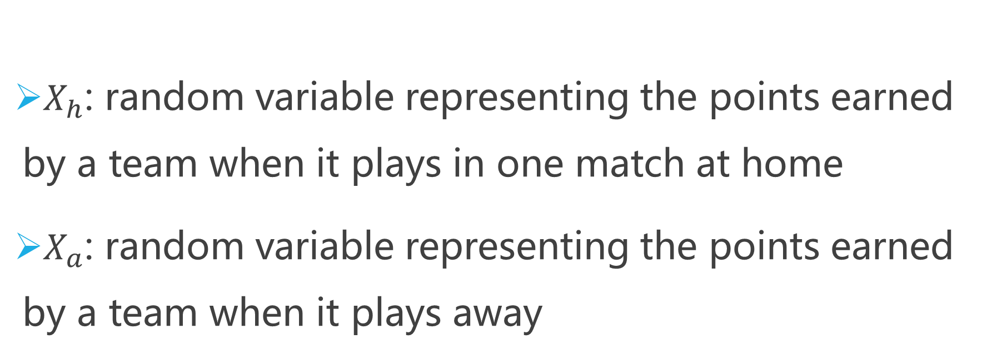
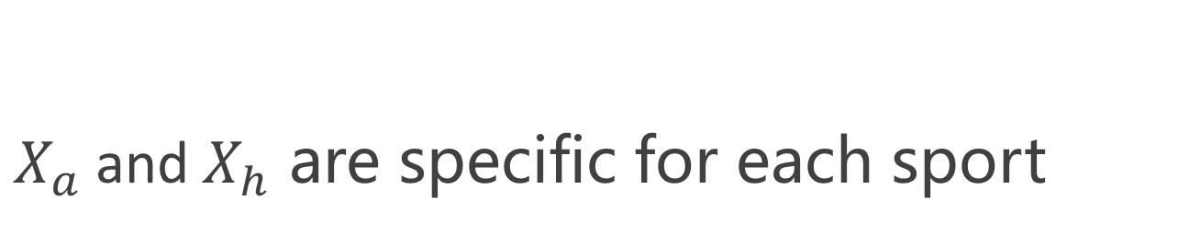
A luck and skill coefficient
$X_{h}$: random variable representing the points earned by a team when it plays in one match at home
$X_{a}$: random variable representing the points earned by a team when it plays away
$X_{a}$and$X_{h}$ are specific for each sport

Slide 10
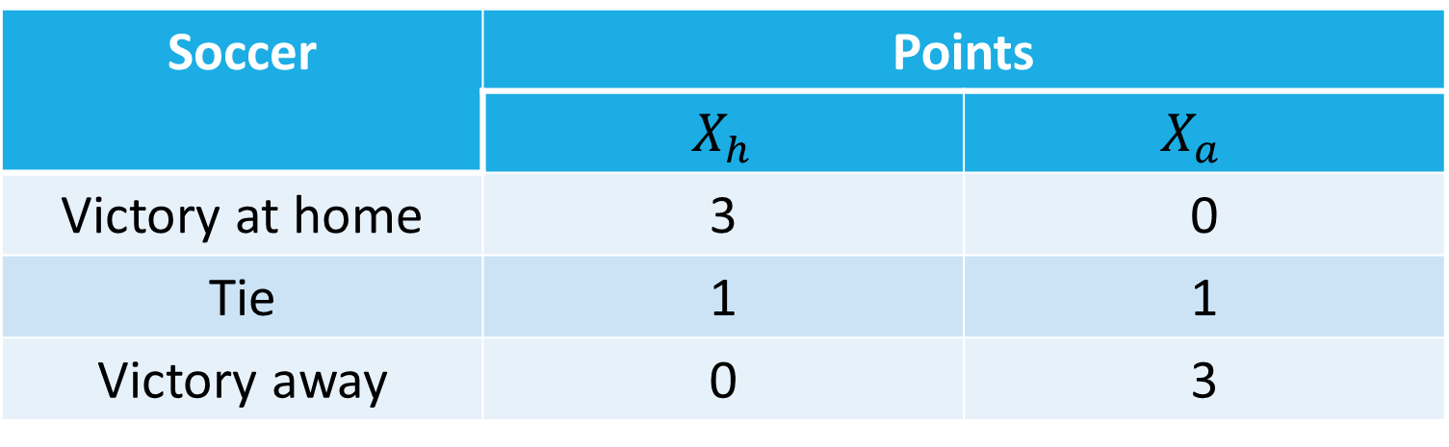
A luck and skill coefficient
For soccer:
Soccer | Points
 | $X_{h}$ | $$X_{a}$$
Victory at home | 3 | 0
Tie | 1 | 1
Victory away | 0 | 3

Slide 11
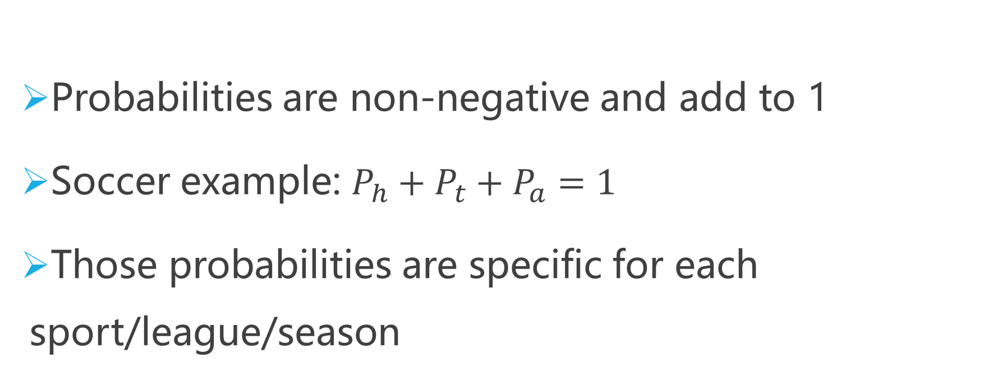
A luck and skill coefficient
Probabilities are non-negative and add to 1
Soccer example: $P_{h}+P_{t}+P_{a}=1$
Those probabilities are specific for each sport/league/season

Slide 12
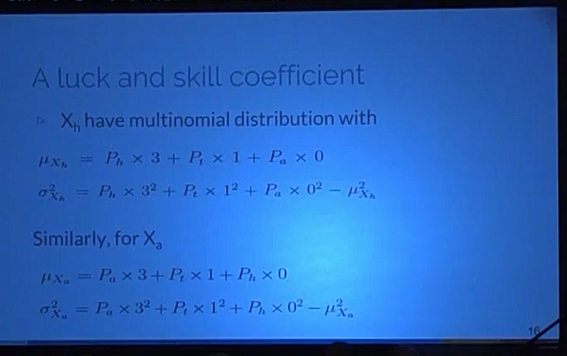
A luck and skill coefficient

Slide 13
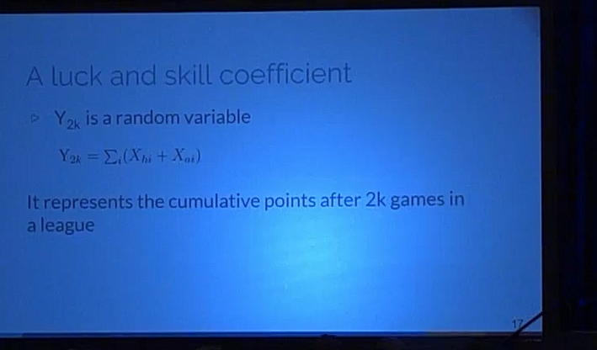
A luck and skill coefficient

Slide 14
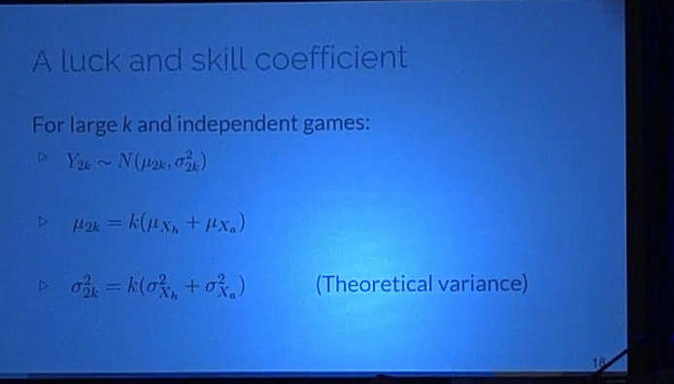
A luck and skill coefficient

Slide 15
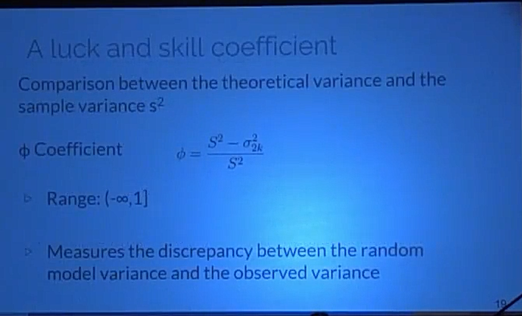
A luck and skill coefficient

Slide 16
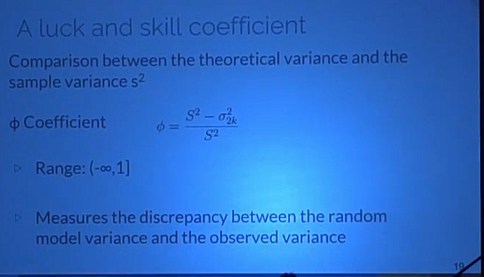
A luck and skill coefficient

Slide 17
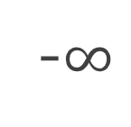
A luck and skill coefficient
-$∞$
0
1
Atypical
Luck
Skill
Close to 1: skill factor has more influence

Slide 18
A luck and skill coefficient
-$∞$
0
1
Atypical
Luck
Skill
Close to 0: skill factor has a small influence in the results

Slide 19
A luck and skill coefficient
-$∞$
0
1
Atypical
Luck
Skill
Negative values: observed variance is LESS than the expected value under the random model

Slide 20

A luck and skill coefficient
Confidence interval(95%) around 0
-$∞$
0
1
Atypical
Luck
Skill
Monte Carlo simulation considering true the random model hypothesis

Slide 21
A luck and skill coefficient
If Ф is significantly different from 0,
how many teams should be removed from a league in order to turn it random?
By repeated simulation

Slide 22
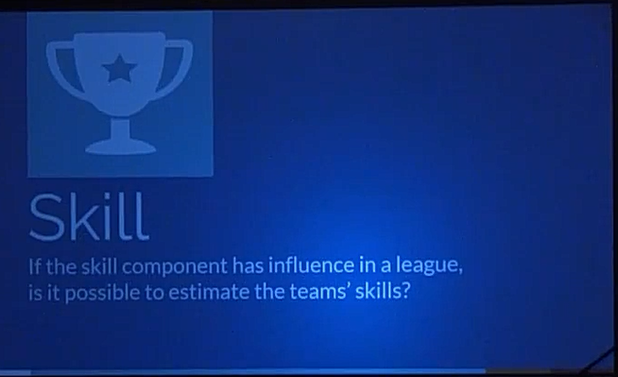

Slide 23
Skill estimation
Probabilities Graphical Model
Seasons/Leagues with significantly different of 0 and positive
Skill component is decomposed into explanatory features
Only basketball, NBA

Slide 24
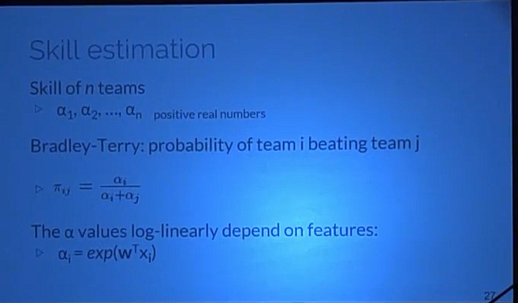
Skill estimation

Slide 25


Skill estimation
Likelihood function:
Games final score
K games and $n$ teams
$N_{k }$: total points of each team
$S_{k}$: points of the home team
$N_{k }$is a sequence of success and failures
$S_{k }$~ Binomial Distribution conditioned in $N_{k }$

Slide 26
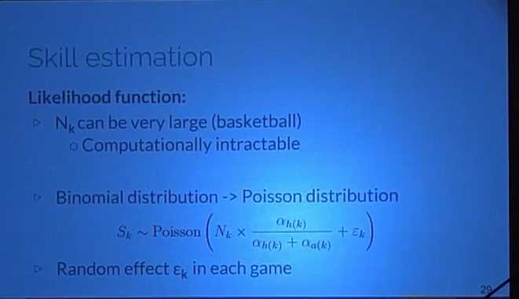
Skill estimation
Likelihood function:

Slide 27
Results
Ф Coefficient

Slide 28
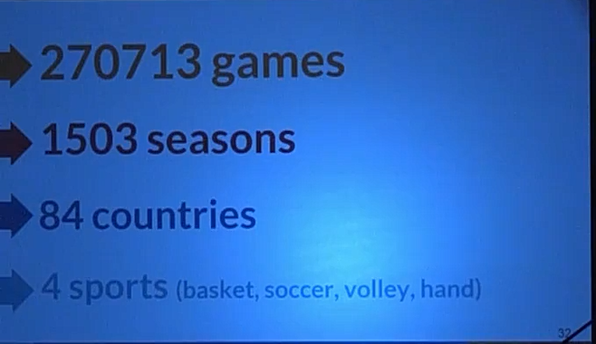

Slide 29
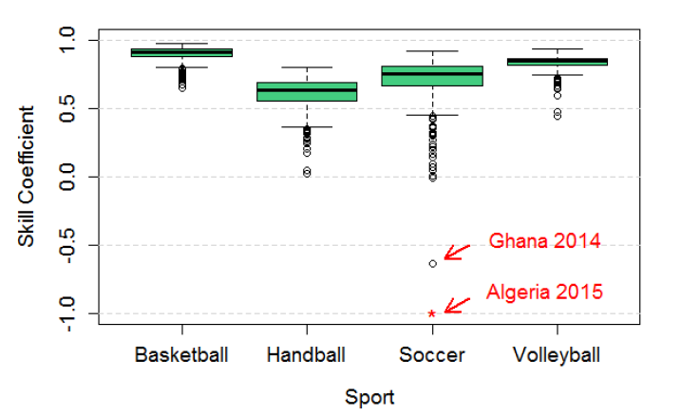
Some results

Slide 30
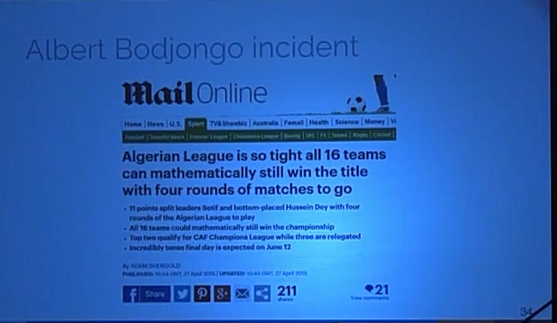
Albert Bodjongo incident

Slide 31
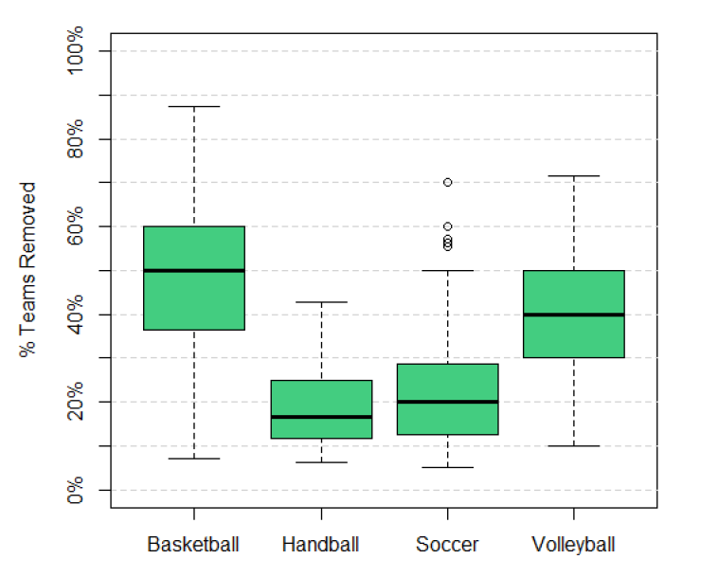
How many teams should be removed to make it random?

Slide 32
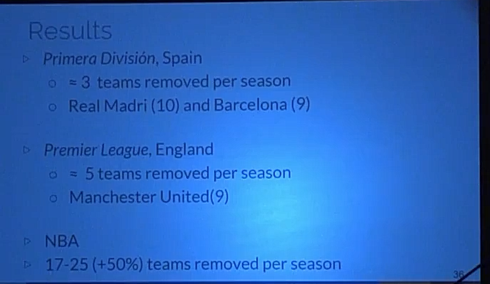
Results

Slide 33
Dados
League
National Basketball Association(NBA)
Regular Season: round-robin system(=1230 matches)
Playoffs: 16 teams

Slide 34
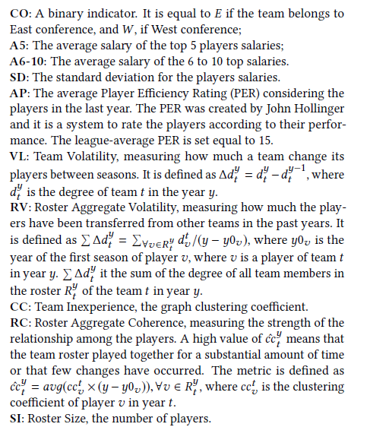
Features

Slide 35
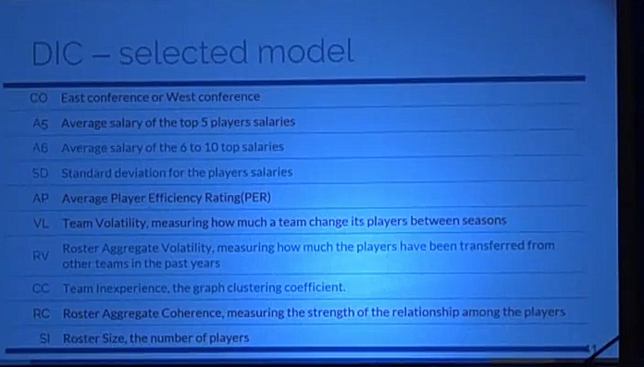
DCI-selected model

Slide 36
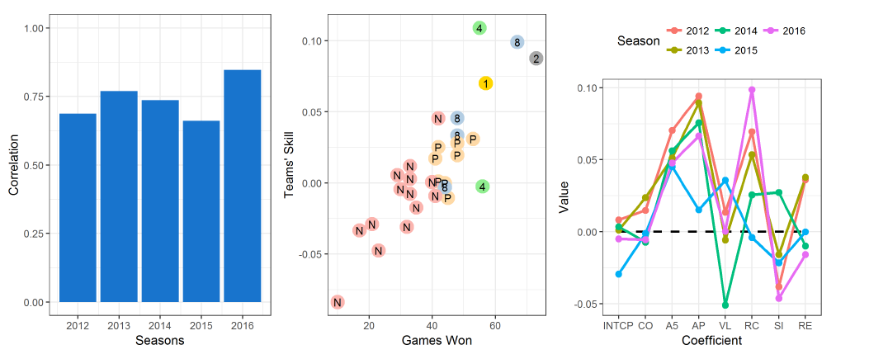

Slide 37
Management strategy
Building smaller teams allow for higher salaries
It also increase the odds of attracting high PER players and increasing rapport(roster aggregate coherence)
Smaller, more cohesive teams have less conflicts and are easier to manage

Slide 38
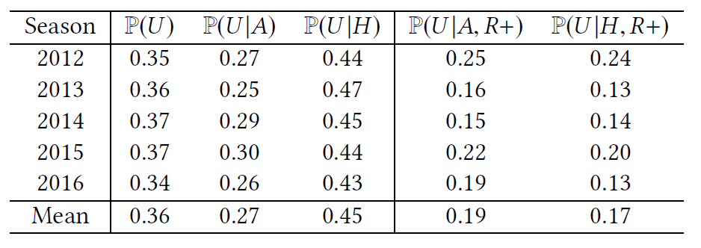
When the underdog plays at home, its winning probability increase 0.18
This effect disappears if playing against the best ones

Slide 39
Conclusion
Goals
Evaluate the luck and skill influence in sports leagues
Estimate the teams' skill

Slide 40
Conclusion
Contribution
Ф coefficient
Which leagues and sports are more competitive
Bayesian model
Which features have more influence on the skill

